Slide 1
REVISITING OBJECT ORIENTED PROGRAMMING IN C# - ADVANCED CONCEPTS

Slide 2
Objective
Using this, base and new keyword
Constructor chaining using base keyword
Using Static members
Polymorphism
Method overload – revisited
Method overriding and virtual – override keyword
Sealed keyword
Abstract class and interface revisited
Operator overloading
Object data type and its members
Data conversion using ‘is’, ‘as’ keyword and boxing/unboxing
Structure and structure vs. class

Slide 3
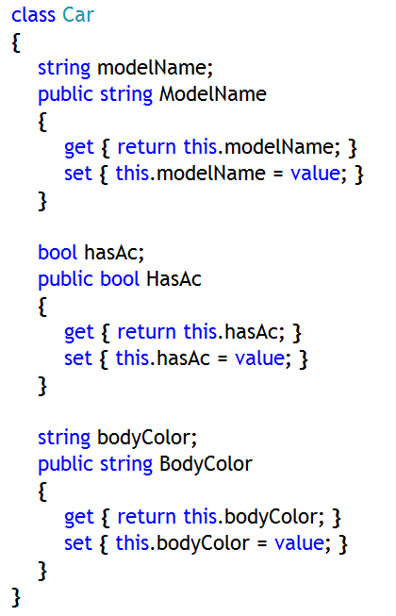
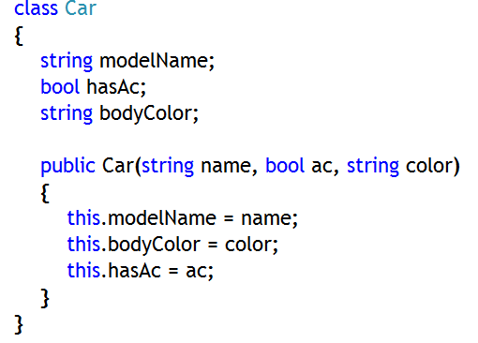
Using this Keyword
‘this’ is a reference to the object of the current class
It can be used to distinguish instance variables from local variables
It can be assigned to other references, or passed as a parameter, or cast to other types
It cannot be used in a static contextUseful when identifiers from different scopes clash
If this statement were
modelname = modelname;
What would happen?

Slide 4
Initializing Data Using Initializer List and this Keyword
Overloaded constructors might contain duplicate code
Re-factor by making constructors call each other
Use the this keyword in an initializer list
class Date
{
...
public Date( ) : this(1970, 1, 1)
{ ….. }
public Date(int year, int month, int day)
{ ... }
}

Slide 5
‘base’ Keyword
‘base’ keyword is used to call any public or protected or internal or protected internal member of base class from the immediate derived class
It can be used to call even any overloaded constructor of base class explicitly
Can’t be used to invoke any private member of base class
Can be used only from immediate child class of any base class, not from any child class present in the hierarchy in a multilevel inheritance

Slide 6
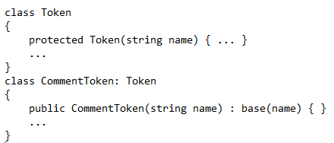
Calling Base Class Constructor Using base Keyword
You can call any base class constructor from child class explicitly, instead of default base class constructor
Constructor declaration in child/derived class must use the base keyword to call particular constructor of base class
Use the base keyword to qualify identifier scope
Notes:
1. Whenever a derived class constructor gets called, always default constructor of base class gets called
2. You can call any base class constructor from child class explicitly, instead of default base class constructor
3. Constructor declaration in child/derived class must use the base keyword to call particular constructor of base class
4. A private base class constructor cannot be accessed by a derived class
5. Use the base keyword to qualify identifier scope

Slide 7
Calling Base Class Method Using ‘base’ Keyword
Even any method or any other member (fields, properties) that are not private can be called from immediate child class using ‘base’ keyword
You can call only immediate base class method from the child class

Slide 8
Example: Using ‘base’ Keyword
Scenario:
Let’s take the same example of InfoSystem Ltd. Company, where we need to calculate salary of different employees
Problem:
Consider, all the common fields in the base class Employee are private. So, no field will be derived in the child classes, SrDeveloper and ProjectManager
Also, salary structure of different employees is different.Consider, ProjectManager has ‘gartuity’ and SrDeveleoper has ‘incentive’ as their extra payment apart from common ‘basic’, ‘da’ and ‘hra’. Now you need to calculate salary for both of them but the salary calculation will be slightly different for each derived class.

Slide 9
Example: using ‘base’ keyword
Solution:
First,
Let’s add overloaded constructors in base class (Employee) as well as in all derived classes (SrDeveloper and ProjectManager).
Call overloaded constructor of derived classes and pass all the required arguments to it, while creating objects of derived classes
Form derived class constructor, using ‘base’ keyword call base class overloaded constructor and pass those same arguments which were passed to derived class overloaded constructor by user
Get all the fields be initialized and also salary be calculated in the base class

Slide 10
Example: using ‘base’ keyword
Solution:
Second,
Let’s add CalculateSalary() method in base class Employee, that will be used to calculate salary based on only ‘basic’, ‘da’ and ‘hra’ and the same method will be inherited in the derived classes
But, since salary calculation for derived classes are different, so, let’s place the CalculateSalary method, with same signature as that of the base class, in the dervied classes too, but with different implementation and from the derived class CalculateSalary method we need to call base class same method using ‘base’ keyword

Slide 11
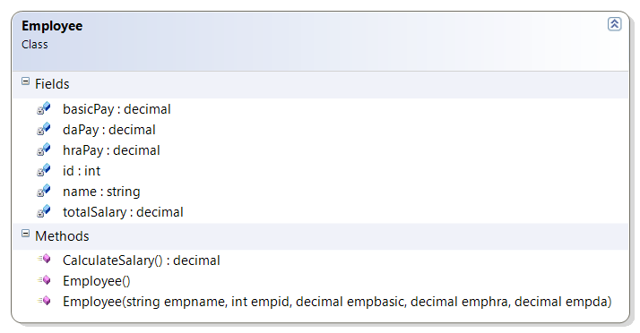
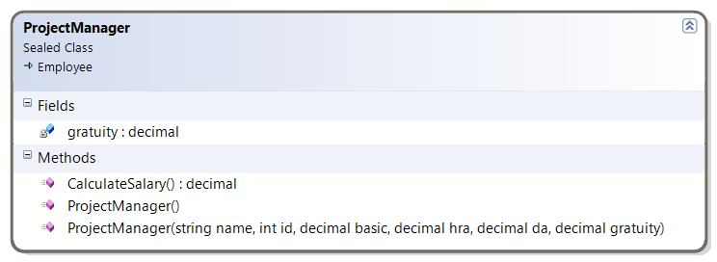
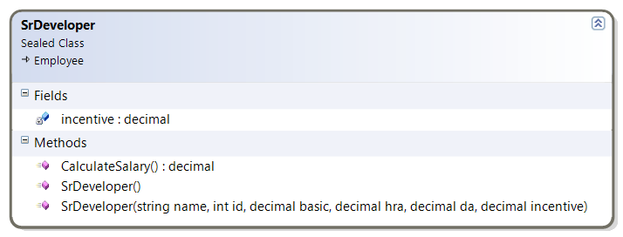
Example: Using ‘base’ Keyword
Class Diagram

Slide 12
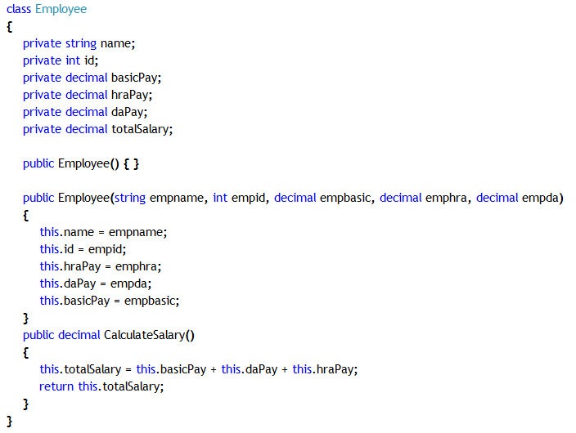
Example: Using ‘base’ Keyword
Employee class code

Slide 13
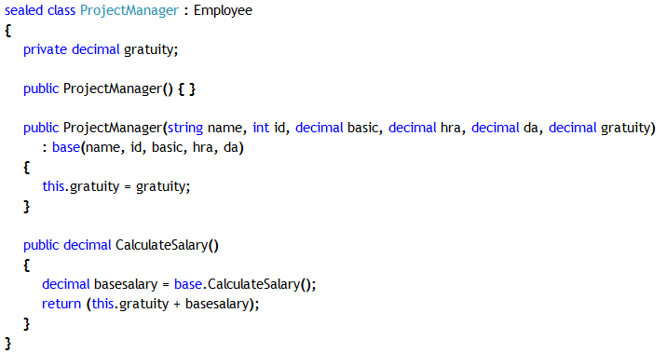
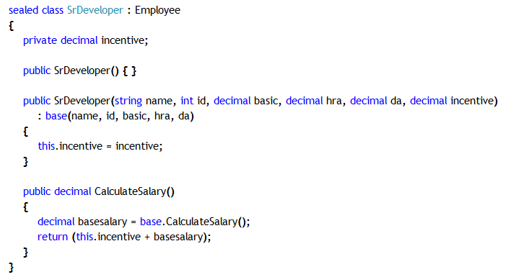
Example: Using ‘base’ Keyword
Derived class code
Both the derived classes are having same CalculateSalary method as that of the Employee base class and from both derived class CalculateSalary method using base keyword Employee class CalculateSalary method is being called to retrieve the salary calculated based on basic, da and hra payment and then their own field value is being added to that calculated amount
Calling base class method as well as constructor using base keyword

Slide 14
Using ‘new’ Keyword
new keyword is used to hide a method
When both base class and derived class have the same method, then base class method can be hidden by child class method with the help of ‘new’ keyword
Example:
class Token
{ ...
public int LineNumber( ) { ... }
}
class CommentToken: Token
{ ...
new public int LineNumber( ) { ... }
}

Slide 15
Example: Using ‘new’ Keyword
Scenario:
Let’s take the same example of InfoSystem Ltd. Company, where we need to calculate salary of different employees
Problem:
Since, salary structure of different employees is different the salary calculation will be slightly different for each derived class. That is why even derived classes had CalculateSalary method with different implementation in the previous solution
Since child class is having two CalculateSalary method, where one is derived and another is it’s own, hence CalculateSalary method of derived class will try to hide same method of the base class. But, that will not be possible and compiler will be generating an error
Solution:
Use ‘new’ keyword with the child class CalculateSalary method, so that now child class method can hide the base class method properly and there will be no compiler generated warning

Slide 16
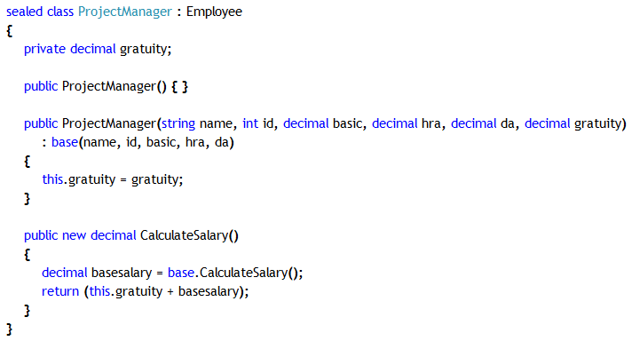
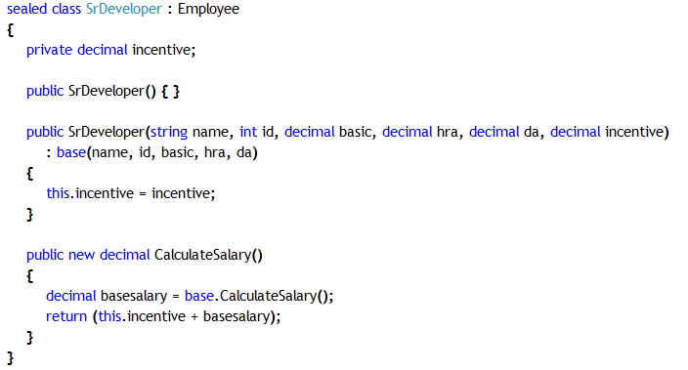
Example: Using ‘new’ Keyword
Derived class code
Both the derived classes now using ‘new’ keyword to properly hide inherited base class CalculateSalary method by same method of derived class properly. So, compiler will not throw any warning this time

Slide 17
Points To Remember About new keyword
Hide both virtual and non-virtual methods using new keyword
Resolve name clashes in code
Hide methods that have identical signatures
class Token
{ ...
public int LineNumber( ) { ... }
public virtual string Name( ) { ... }
}
class CommentToken: Token
{ ...
public new int LineNumber( ) { ... }
public new virtual string Name( ) { ... }
}

Slide 18
Static Member
Static data describes information for all objects of a class
For example, suppose all accounts share the same interest rate. Storing the interest rate in every account would be a bad idea.
Make it a static data
Withdraw( )
Withdraw( )
Deposit( )
Deposit( )
balance 12.56
balance 99.12
û
û
interest 7%
interest 7%

Slide 19
Using Static Methods
Static methods can only access static data
A static method is called on the class, not the object
The account class
An account object
û
Withdraw( )
InterestRate( )
Deposit( )
✓
û
balance 99.12
interest 7%
owner "Fred"
Classes contain static data and
static methods
Objects contain object data and
object methods

Slide 20
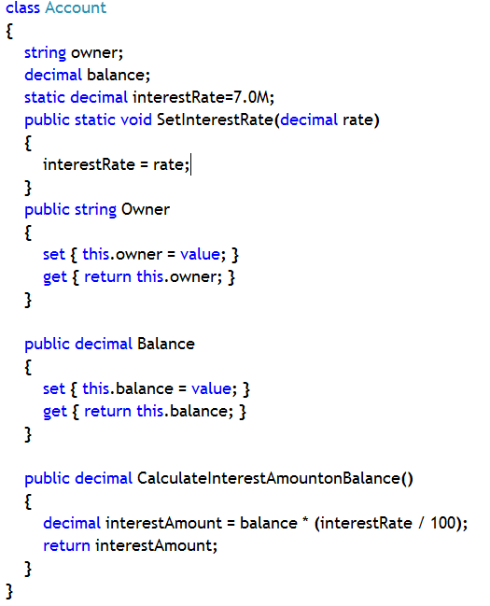
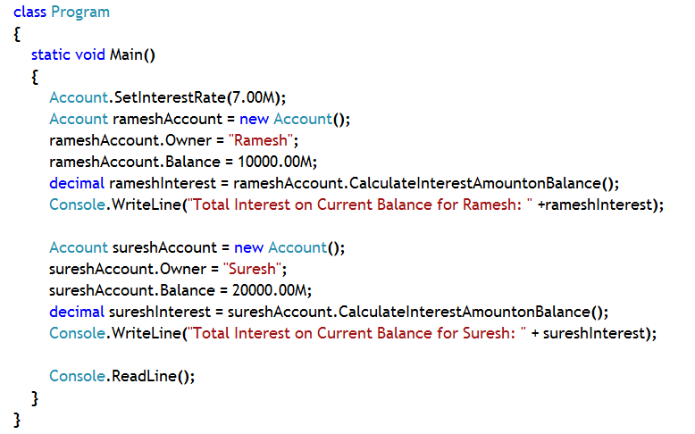
Example: Static Method
Both Ramesh and Suresh gets the same interest on the amount. So it is wise to be kept as static data, which is not different for different user
Static method to assign value to interest rate
Notes:
In this example:
Account is class which represents accounts of different persons
It has three fields, namely ‘owner’ and ‘balance’ and ‘interestRate’.
Interest rate is same for all account holders. So, it is not necessary to be a instance field, rather it is a static field.
Sinec, ‘iterestRate’ has been declared as a static field, it will not be part of any instance. It will be accessed using class name.
A static method has been provided to set the value for interest rate, too. In static method you can only use static data.
CalculateInterestAmountonBalance method calculates total interest amount generated for the current balance for the account holder.
To objects of Account class has been created, one for Mr. Ramesh and another for Mr. Suresh
Some amount is there in their account as Balance
Interest amount has been calculated based on the same interest rate for the available balance.
So, static member is shared amongst different user. It is not stored as a part of the instance.
Notice: Balance is different for different object (as well as Owner data)
Balance (and Owner) is instance data, contains different values for different instances

Slide 21
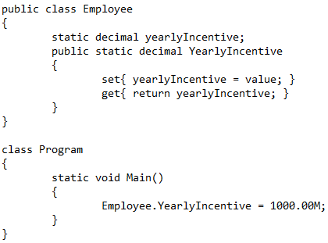
Static Property: Example
A property declared with static keyword is said to be static property
A static property is accessed with class name

Slide 22
Static Constructor
Constructor can be static, too.
Purpose
Called by the class loader at run time
Called only once in the application lifetime, no matter how many objects are created. It is called just before the first object creation.
Guaranteed to be called before instance constructor
At least one object of the class has to be created, so that at least once the instance constructor gets called
Can be used to initialize static fields
Restrictions
Cannot be called
Cannot have an access modifier
Must be parameter less (i.e., can’t be overloaded)

Slide 23
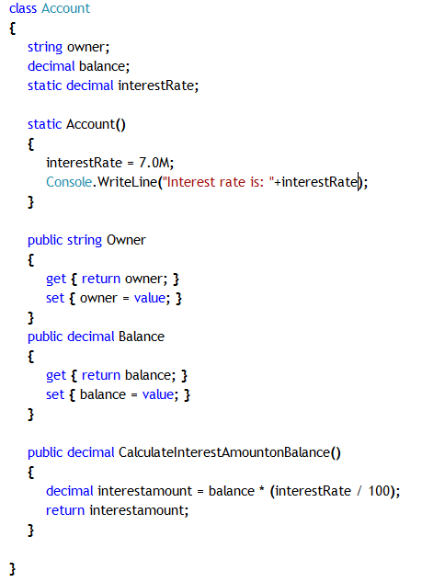
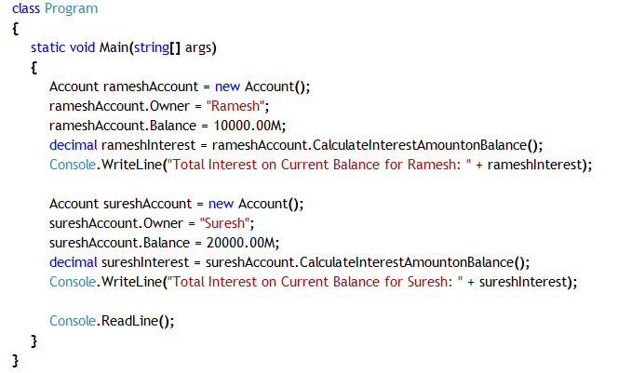

Example:
Instead of a static method, ‘interestRate’ variable is being assigned in a static constructor
Notice, static constructor has been executed only once, though two objects of Account class has been created

Slide 24
Comparison Between Static and Non-static data
Static Member | Non-Static Member
1. Static data and static method are not accessed through instances, rather through class name | 1. Non-static data and method are accessed through instances, not using class name
2. Only single copy of static data member will be present and every instance will share that static data | 2. Non-static data is different for different instances and it is not shared amongst different instances. It is particular to the instance
3. Static method can only access static data | 3. Non-static method can access static as well as non-static data

Slide 25
Polymorphism and Types of Polymorphism
Poly (=many) and Morph (=form)
Different implementation with same name
There are two types of polymorphism
If normal member calls are resolved at compile time, then it is known as Early Binding or Static Polymorphism. Method overloading is an example of Static polymorphism.
If polymorphic member calls are resolved at run time then it is known as Late Binding or Dynamic Polymorphism
Notes:
Method overloading: The same class has many methods with same name
Method overriding: The method name resides in the base class and the method implementations reside in the derived classes

Slide 26
Method Overloading Revisited
It is an example of early binding or static polymorphism
Which method will be called that is decided during compile time
All the overloaded methods, with same name, are part of single class
Method signatures must be unique within a class
Signature definition makes the difference
Criteria for Signature Difference
Which Does Not Have An Impact On Signature?
No of Parameters
Data Type of Parameters
Position of Parameters
Name of parameter
Return type of method

Slide 27
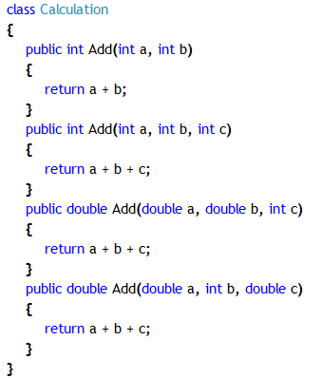
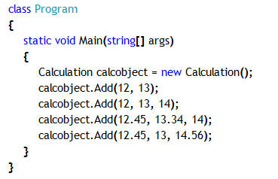
Declaring Overloaded Methods
Calculation is having four overloaded ‘Add’ methods with four different signatures
During method calls, each and every method call will be attached to proper overloaded method with the help of method signature

Slide 28
What is Method Overriding?
It is an example of Dynamic Polymorphism
It is required when you need to provide a new implementation of the base class method in the derived class without changing the signature of the method and also to invoke that child class implementation always, no matter where the reference is passed, either to base or child class variable
Technique:
Declare base class method with ‘virtual’ keyword
Override base class method in derived class by using ‘override’ keyword with derived class method
In this way, in the derived class you are providing new implementation to the same method of base class
Notes:
Note:
1. You cannot declare virtual methods as static
2. You cannot declare virtual methods as private
3. Virtual methods are supposed to be overriden by the new implementation of the same method in the child class
4. Base class method may be declared with ‘virtual’, but derived class may or may not override that base class method
5. If derived class wants to override the base class method, then use the override keyword while providing new implementation of the same method in the child class

Slide 29
Why Method Overriding?
A Scenario:
Let’s take the same example of InfoSystem Ltd. Company, where we need to calculate salary of different employees based on their different salary structure
Problem:
Since salary calculation for them was different for them, so derived classes had their own implementation of CalculateSalary method.
But, an object of derived class (say, SrDeveloper) was created and the reference was passed to base class (Employee) variable. While calling the CalculateSalary method through base class variable, always method from base class was being invoked. But, if the same reference is passed to the derived class variable and then CalculateSalary method is called, then the method from derived class is invoked.

Slide 30
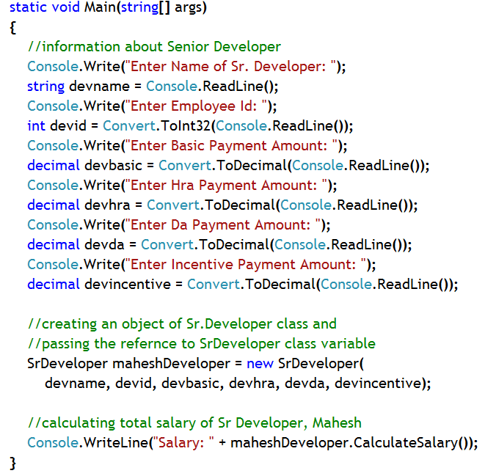

Why Method Overriding?
Stack
Heap
CalculateSalary of base
CalculateSalary of child
Reference of object
maheshDeveloper (of type SrDeveloper class)
SrDeveloper class object
Notice the salary is 45,000, which is expected output, since derived class method is being called

Slide 31
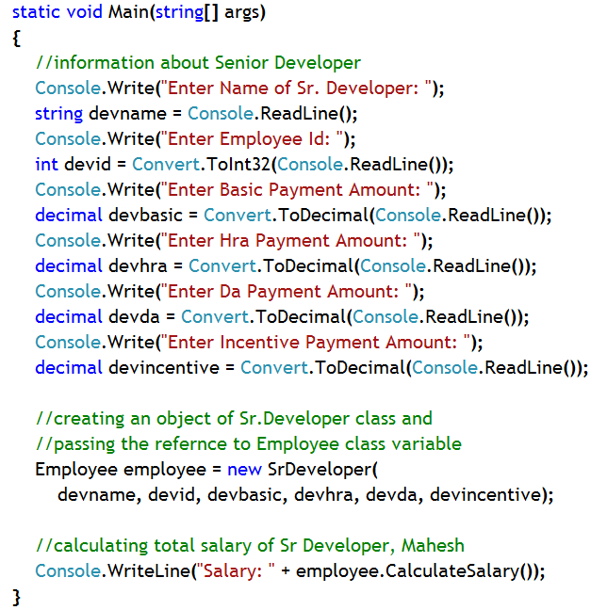

Why Method Overriding?
Stack
Heap
CalculateSalary of base
CalculateSalary of child
Reference of object
employee (of type Employee class)
SrDeveloper class object
Notice, the salary is 40,000 instead of 45,000, which is unexpected output, since base class method is being called

Slide 32
Why Method Overriding?
Solution:
That means, not only CalculateSalary() has to be implemented in the derived classes with different logic, also CalculateSalary method of derived class should be invoked always, no matter to whom the reference of derived class is passed
To solve the problem in this scenario, you need help of Method Overriding technique

Slide 33
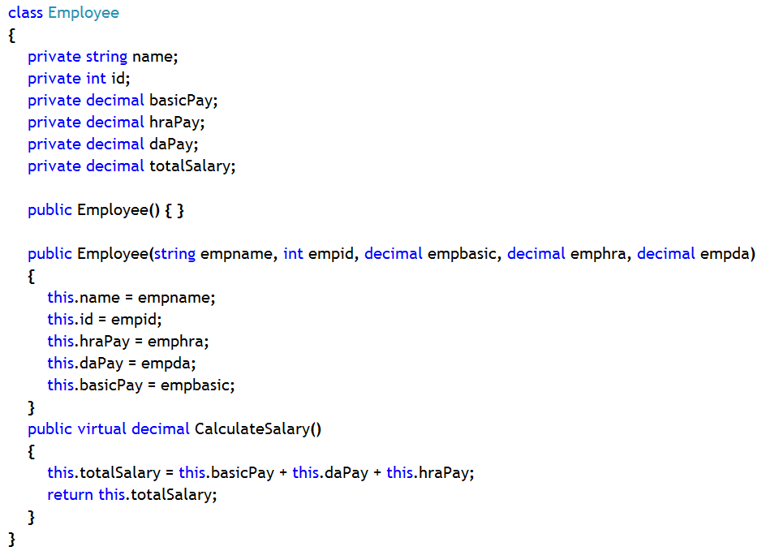
Example: Method Overriding
Employee class code

Slide 34
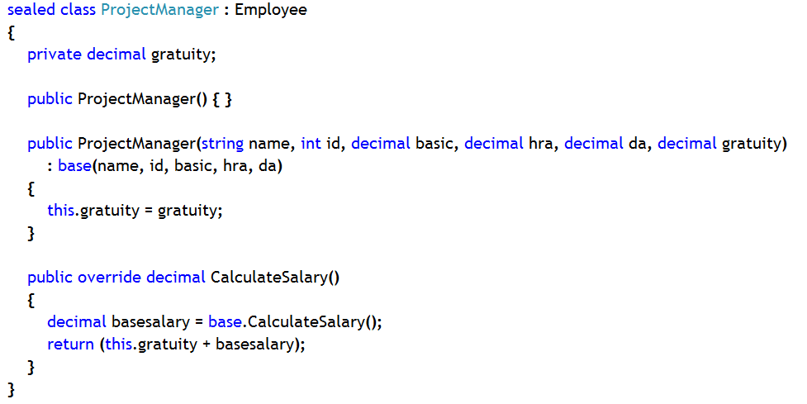
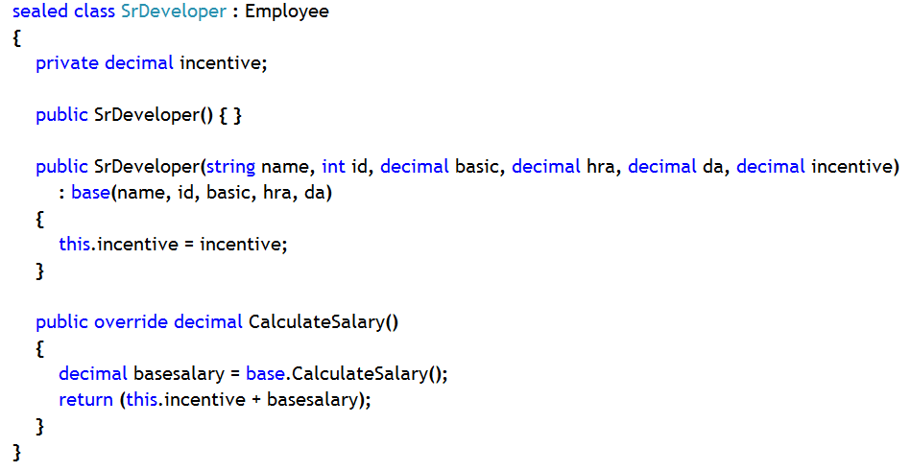
Example: Method Overriding
Derived class code

Slide 35
Example: Method Overriding
Recap to Scenario Problem
Stack
Heap
CalculateSalary of base
CalculateSalary of child
Reference of object
maheshDeveloper (of type SrDeveloper class)
SrDeveloper class object
Notice the salary is 45,000, which is expected output, since derived class method is being called like previous case

Slide 36
Example: Method Overriding
Recap to Scenario Problem
Stack
Heap
CalculateSalary of child
Reference of object
employee (of type Employee class)
SrDeveloper class object
Notice the salary is 45,000, which is expected output, since derived class method is being called though the reference of the child class object is with the base class variable

Slide 37
Important Points To Remember About Overriding
You can only override identical inherited virtual methods. That means you must match an override method with its associated virtual method
You can override a virtual or override or an abstract method of base class
You cannot explicitly declare an override method as virtual
You cannot declare an override method as static or private
class Token
{ ...
public int LineNumber( ) { ... }
public virtual string Name( ) { ... }
}
class CommentToken: Token
{ ...
public override int LineNumber( ) { ... }
public override string Name( ) { ... }
}
û
✓

Slide 38
‘sealed’ keyword: Sealed class
A sealed class is the one which you cannot derive from
Declare a class with sealed keyword to make it a sealed class
You can use sealed classes for optimizing operations at run time
Many .NET Framework classes are sealed: String, StringBuilder, and so on
Example:
namespace System
{
public sealed class String
{
...
}
}
namespace Mine
{
class FancyString: String { ... }
}
û
Notes:
A sealed class cannot be used as a base class. For this reason, it cannot also be an abstract class. Sealed classes prevent derivation. Because they can never be used as a base class, some run-time optimizations can make calling sealed class members slightly faster.

Slide 39
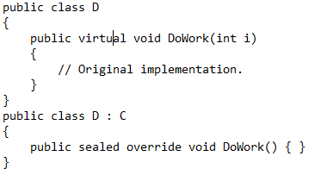
‘sealed’ keyword: Sealed Method/Properties
A method, property etc. on a derived class that is overriding a virtual member of the base class can declare that member as sealed.
This negates the virtual aspect of the member for any further derived class.
This is accomplished by putting the sealed keyword before the override keyword in the class member declaration.
Notes:
The sealed keyword can be used ONLY with members declared with override keyword, NOT with any member
This is done to stop further overriding of already overridden members of a class in its derived classes

Slide 40
Revisiting Abstract Class and Method: Through a Scenario
Scenario:
Let’s take the same example of InfoSystem Ltd. Company, where we need to calculate salary of different employees based on their separate salary structure
Problem:
New implementation of the same base class CalculateSalary method was provided in each derived classes. Even, base class method was declared as virtual, so that derived classes can override the base class implementation and it was made sure through overriding that always derived class method will be invoked though a derived class object, no matter whether the reference is placed in base or derived class variable
But, if all the derived classes are ultimately going provide new implementation to the base class method, then why to provide implementation logic in the base class CalculateSalary method?
Solution:
Do not provide implementation logic in CalculateSalary method of base class

Slide 41
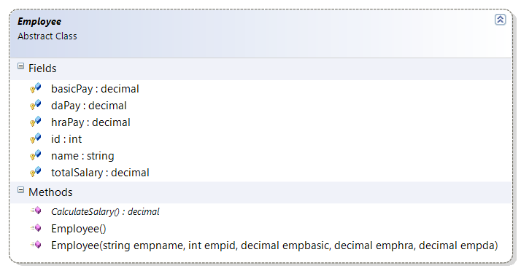
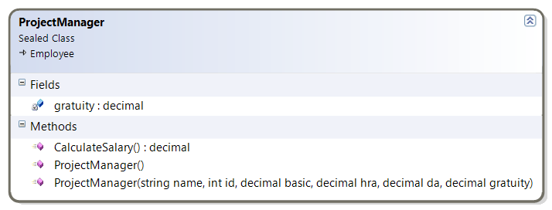
Example: Abstract Class
Class Diagram

Slide 42
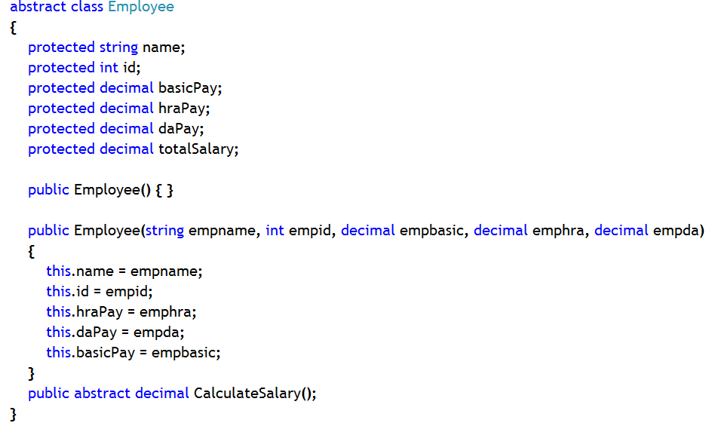
Example: Abstract Class
Employee class code

Slide 43
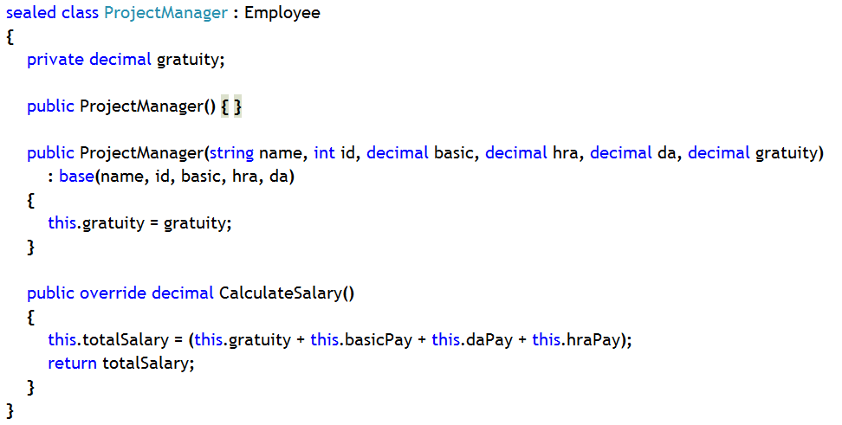
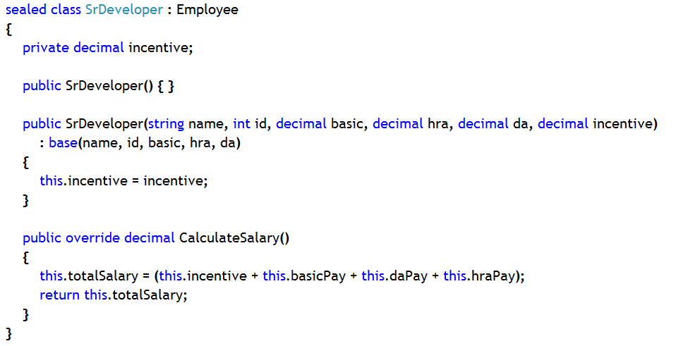
Example: Abstract Class
Derived class code
By default, abstract members are virtual. So, while implementing them in the derived class, one should use ‘override’ keyword

Slide 44
Important Points to Remember About Abstract
Abstract methods have to be implemented in the child class. Otherwise, child class will also become abstract class
Abstract methods/properties are by default virtual. So, while providing implementation in derived class you have to use ‘override’ keyword
Abstract class objects can’t be created
Abstract class variable can hold reference of child class objects (Upcasting)
Abstract class is basically used as a template for other classes. All members, that you want to implement differently in different child classes, should be declared as abstract members in an abstract base class

Slide 45
Revisiting Interface
Interface is a pure abstract class. That means, all the members of an interface are pure abstract.
It does not contain any member with implementation
interfaces are for realization relationship.
A Realization is a relationship between two elements, in which one element (the client) realizes the behavior that the other element (the supplier) specifies.
Objects of interface can’t be created.

Slide 46
Implementing Interface Members Implicitly
The implementing method must be the same as the interface method
The implementing method can be non-virtual or virtual
class Token: IToken, IVisitable
{
public string Name( )
{ ...
}
public void Accept(IVisitor v)
{ ...
}
}
Same access
Same return type
Same name
Same parameters
public virtual string Name( )
{ ...
}

Slide 47
Calling interface methods
Calling interface methods Implicitly
Calling interface Explicitly
Token class object
created and method
is being called through
the object reference
Token tokenobject = new Token();
Tokenobject.Name();
Token tokenobject = new Token();
IToken itocken = tokenobject;
itocken.Name();
Token class object
created and then reference
is passed to a variable of
the interface and through
that reference variable method
is being
Notes:
Note: If you implement a member of an interface in a class implicitly, you can call that member implicitly or explicitly, i.e., using nay of the ways.

Slide 48
Implementing Interface Methods Explicitly
Use the fully qualified interface method name.
No public keyword
Restrictions of explicit interface method implementation
You can only access methods through the interface
You cannot declare methods as virtual
You cannot specify an access modifier
class Token: IToken, IVisitable
{
string IToken.Name( )
{ ...
}
void IVisitable.Accept(IVisitor v)
{ ...
}
}
class Program
{
Static void Main()
{
Token tokenobj = new Token();
IToken itoken = tokenobj;
itoken.Name();
Ivisitable ivisit = tokenobj;
ivisit.Accept(ivisitor);
}
}

Slide 49
Interface in an Hierarchy
IMusician is an interface with PlayMusic() method, which is not implemented in Musician class, but implemented in derived class ViolinPlayer
IMusician
void PlayMusic();
« interface »
Interface: Nothing but operations.
You cannot create instances of an interface.
Abstract Class: May contain some
implementation. You cannot create instances of an abstract class.
Musician
public abstract void PlayMusic();
{ abstract }
Derived Class: Must implement all
inherited operations. You can create instances of a concrete class.
Violin Player
public override void PlayMusic(){ //code}
« concrete »

Slide 50
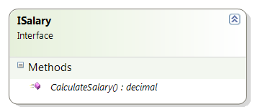
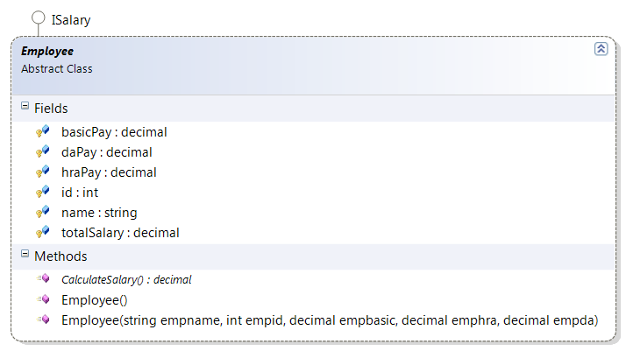
Example: Interface
Class and interface diagram

Slide 51
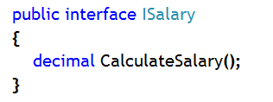
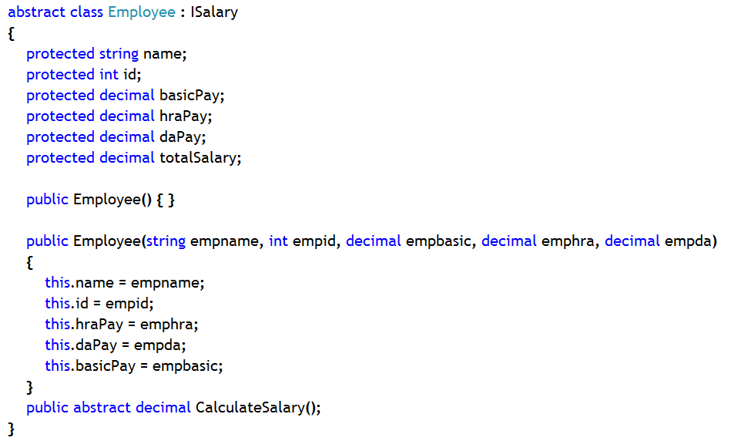
Example: Interface
ISalary interface and Employee class code

Slide 52
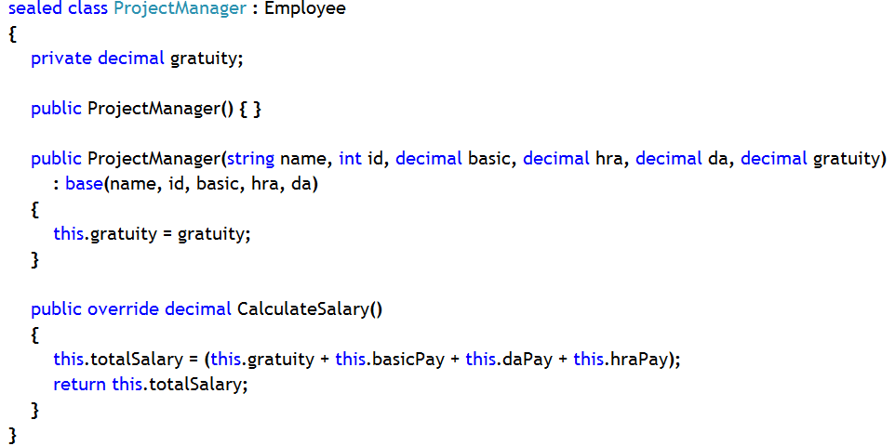
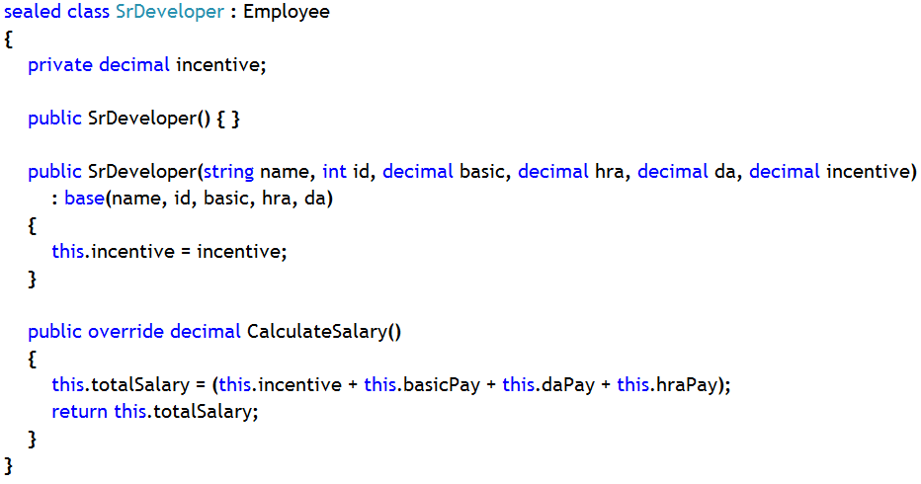
Example: Interface
Derived Class code

Slide 53
Comparing Abstract Classes to Interfaces
Abstract class | Interface
1. Can’t be instantiated (similarity) | 1. Can’t be instantiated
2. Can’t be sealed (similarity) | 2. Can’t be sealed
3. Contain abstract as well as non-abstract members | 3. Can’t contain any non-abstract members
4. Can contain fields (data members) | 4. Can’t contain fields (data members)
5. Can contain non-public members | Can’t contain non-public members
6. By default members are private | 6. By default members are public
7. Can extend interfaces (similarity) | 7. Can extend interfaces
8. Can extend non-interfaces, such as another class | 8. Can’t extend non-interfaces

Slide 54
Operator Overloading
Operators and Methods
Introduction to Operator Overloading
Overloading Relational Operators
Overloading Logical Operators
Overloading Conversion Operators
Overloading Operators Multiple Times

Slide 55
Operators and Methods
Using methods
Reduces clarity
Increases risk of errors, both syntactic and semantic
Using operators
Makes expressions clear
myIntVar1 = Int.Add(myIntVar2,
Int.Add(Int.Add(myIntVar3,myIntVar4 ),33)
);
myIntVar1 = myIntVar2 + myIntVar3 + myIntVar4 + 33;

Slide 56
Introduction to Operator Overloading
Operator overloading
Define your own operators only when appropriate
Operator syntax
Operatorop, where op is the operator being overloaded
Example
public static Time operator+(Time t1, Time t2)
{
int newHours = t1.hours + t2.hours;
int newMinutes = t1.minutes + t2.minutes;
return new Time(newHours, newMinutes);
}

Slide 57
Overloading Relational Operators
Relational operators must be paired
< and >
<= and >=
== and !=
Override the Equals method if overloading == and !=
Override the GetHashCode method if overriding equals method

Slide 58
Overloading Logical Operators
Operators && and || cannot be overloaded directly
They are evaluated in terms of &, |, true, and false, which can be overloaded
x && y is evaluated as T.false(x) ? x : T.&(x, y)
x || y is evaluated as T.true(x) ? x : T.|(x, y)

Slide 59
Overloading Conversion Operators
Overloaded conversion operators
If a class defines a string conversion operator
The class should override ToString
public static explicit operator Time (float hours)
{ ... }
public static explicit operator float (Time t1)
{ ... }
public static implicit operator string (Time t1)
{ ... }

Slide 60
Overloading Operators Multiple Times
The same operator can be overloaded multiple times
public static Time operator+(Time t1, int hours)
{...}
public static Time operator+(Time t1, float hours)
{...}
public static Time operator-(Time t1, int hours)
{...}
public static Time operator-(Time t1, float hours)
{...}

Slide 61
The ‘object’ Type
‘object’ Base class for all classes
Present in System namespace
Object
String
Exception
MyClass
SystemException

Slide 62
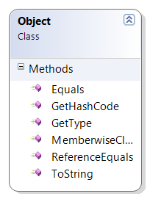
Members of ‘object’ type
Equals(object obj): Determines whether the specified System.Object instances are considered equal. Returns boolean value.
GetHashCode(): Serves as a hash function for a particular type. Returns integer value.
GetType(): Gets the System.Type of the current instance. Returns Type class.
ToString(): Returns a System.String that represents the current System.Object.

Slide 63
Data Conversions
The is Operator
The as Operator
Conversions and the object Type
Boxing and Unboxing

Slide 64
The is Operator
Returns true if a conversion can be made
Bird b;
if (a is Bird)
b = (Bird) a; // Safe
else
Console.WriteLine("Not a Bird");

Slide 65
The as Operator
Converts between reference types, like cast
On error
Returns null
Does not raise an exception
Bird b = a as Bird; // Convert
if (b == null)
Console.WriteLine("Not a bird");

Slide 66
Conversions and the object Type
The object type is the base for all classes
Any reference can be assigned to object
Any object variable can be assigned to any reference
With appropriate type conversion and checks
The object type and is operator
object ox;
ox = a;
ox = (object) a;
ox = a as object;
b = (Bird) ox;
b = ox as Bird;

Slide 67
Boxing and Unboxing
Boxing: Converting value type into reference type
Unboxing: Converting the reference type back to the same value type
While unboxing you have to convert the reference type back to the same data type first and then it can cast to any other data type (implicit).
int p = 123;
object box;
box = p;
p = (int)box;
123
•
123

Slide 68
Structure
A structure is a user-defined value type data type, which is a collection of different data type variables
Memory space for structure variable, unlike class variable, is declared in the stack. This memory space is collective memory space of the containing variables
It is used to encapsulate characteristics and behaviors of light-weight objects.
Such as, Point can be represented as a struct rather than a class

Slide 69
Using a Structure
Defining a Structure Type
Declaring variable of a Structure Type
public struct Employee
{
public string firstName;
public int age;
}
Employee companyEmployee;
companyEmployee.firstName = "Joe";
companyEmployee.age = 23;
--or—
Employee companyEmployee = new Employee();
//calling default constructor of structure to initialize fields of struct
companyEmployee.firstName = "Joe";
companyEmployee.age = 23;

Slide 70
Declaring a Constructor for a Struct
The compiler
Always generates a default constructor. Default constructors automatically initialize all fields to zero.
The programmer
Can never declare a default constructor.
Can never declare a protected constructor.
Can declare constructors with one or more arguments * (overloaded constructors). Declared constructors do not automatically initialize fields to zero.
public struct Employee
{
public string firstName;
public int age;
public Employee()
{
firstName=“Joseph”;
age=30;
}
public Employee(string fname,
int empAge)
{
firstName= fname;
age= empAge; }
}
✗
✓
Notes:
Note:
* --→ You can declare many overloaded constructors, but all of them have to assign value to fields. So, practically, only one overloaded constructor is enough to do the job.

Slide 71
Difference between a Structure and a Class
Structure | Class
1. Structure is value type | 1. Class is reference type
2. Memory space allocation of structure involves only stack | 2. Memory space allocation of class involves stack as well as heap
3. Structure is used represent light weight object | 3. Class is used to represent heavy weight objects
4. Structure variable can be declared using new keyword, too. | 4. Use of ‘new’ keyword is mandatory to create class objects.
5. By default constructor is supplied by compiler if and only if any structure variable is declared using ‘new’ keyword | 5. Default constructor is not supplied by compiler always if you try to create object of a class
6. Overloaded constructor of structure has to initialize all the fields | 6. Overloaded constructor of class needs not to initialize all the fields
7. Object of structure is never created | 7. Class objects are always created

Slide 72
Reference
http://www.codeproject.com/Articles/330447/Understanding-Association-Aggregation-and-Composit
For more information on interfaces, please visit the following link
http://msdn.microsoft.com/en-us/library/ms173156.aspx
For more information on polymorphism, please visit the following link
http://msdn.microsoft.com/en-us/library/ms173152.aspx
For more information on abstract class, please visit the following link
http://msdn.microsoft.com/en-us/library/ms173150.aspx
For more information on static and static class members, please visit the following link
http://msdn.microsoft.com/en-us/library/79b3xss3.aspx
Notes:
Reference

